Slide 1
Come in Quietly
Take out a piece of binder paper, pen or pencil.
Take out your chromebook

Slide 2
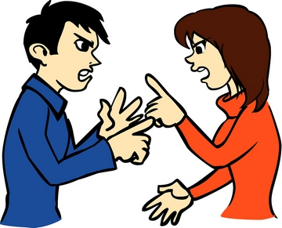
What Is Conflict?
Obj: Define and explain conflict and how it affects humans.
Bell Work
Why were the 13 colonies important?
¿Por qué son importantes las 13 colonias?
Standard 8.1: Students understand the major events preceding the founding of the nation and relate their significance to the development of American constitutional democracy.

Slide 3
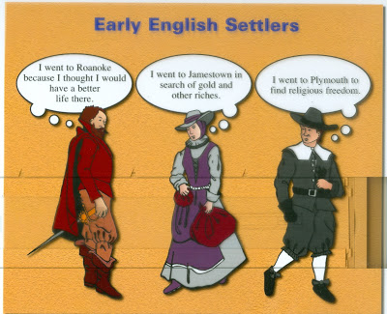
Prior Knowledge
We already know that people from many countries immigrated to America.
Some of those people immigrated voluntarily and others were forced to immigrate.
What were some of the pull factors that brought these immigrants to America?
Start a New Life
Get Rich and Escape Debt
Practice Their Religion Freely

Slide 4
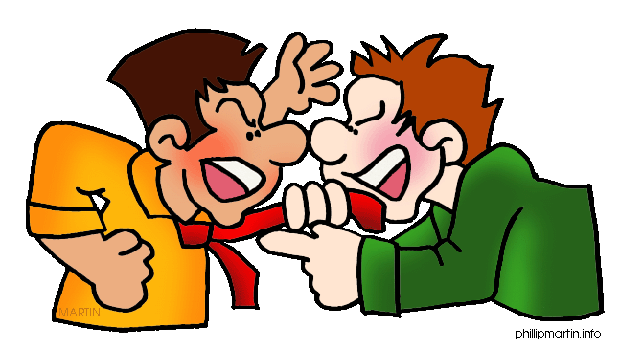
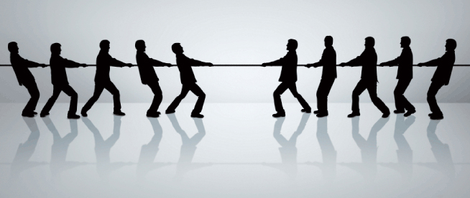
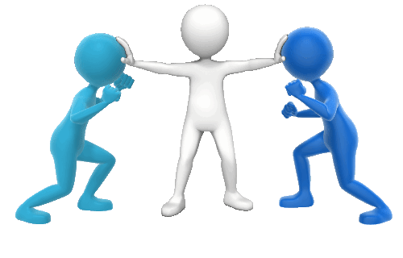
Definitions
Argument - an exchange of different or opposite views, typically a heated or angry one.
Conflict - a serious disagreement or argument, typically a long term one.
Disagreement - an argument caused by people having different opinions about something.
War - a state of armed conflict between different nations or states or different groups within a nation or state.
Resolution - the action of solving a problem.

Slide 5

Concept - Conflict
Conflict and disagreements have existed as long as humans have existed.
“...Conflict can stretch from a mild disagreement to all out war, and is an inevitable element of interpersonal communication. . ... Managing conflict is a skill that is necessary to deal with day to day life. …”
Do you agree that conflict is inevitable (can’t be avoided) or do you disagree? Explain your position and back it up with your own experiences as evidence.

Slide 6
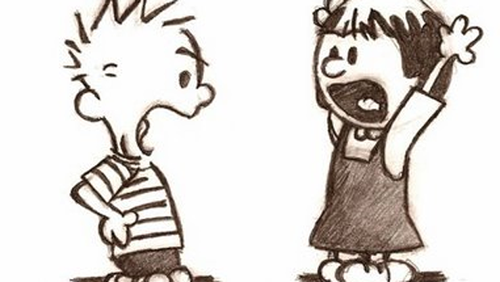
Concept - Conflict
“... For anything to strike interest into the human mind, there must be conflict. For without such conflict life is dull, and there would not be any development of character.”
Do you agree that conflict is necessary to keep life interesting and help build character or do you disagree? Explain your position and back it up with your own experiences as evidence.

Slide 7
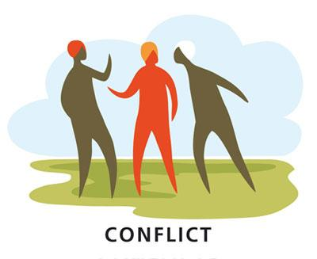
Closure
Answer the following questions.
What is a conflict?
Do you believe that conflict must happen?
If yes explain why. If no explain why not.

